Slide 1
Global Superstore is growing, but profit leaks are concentrated
From 2011 to 2014, sales reached $12.64M and profit $1.47M across 25,035 orders — with a small number of controllable loss drivers.
Notes:
From 2011 to 2014, Global Superstore grew to $12.64M in sales and $1.47M in profit across 25,035 orders. The analysis isolates a small number of controllable loss drivers.

Slide 2
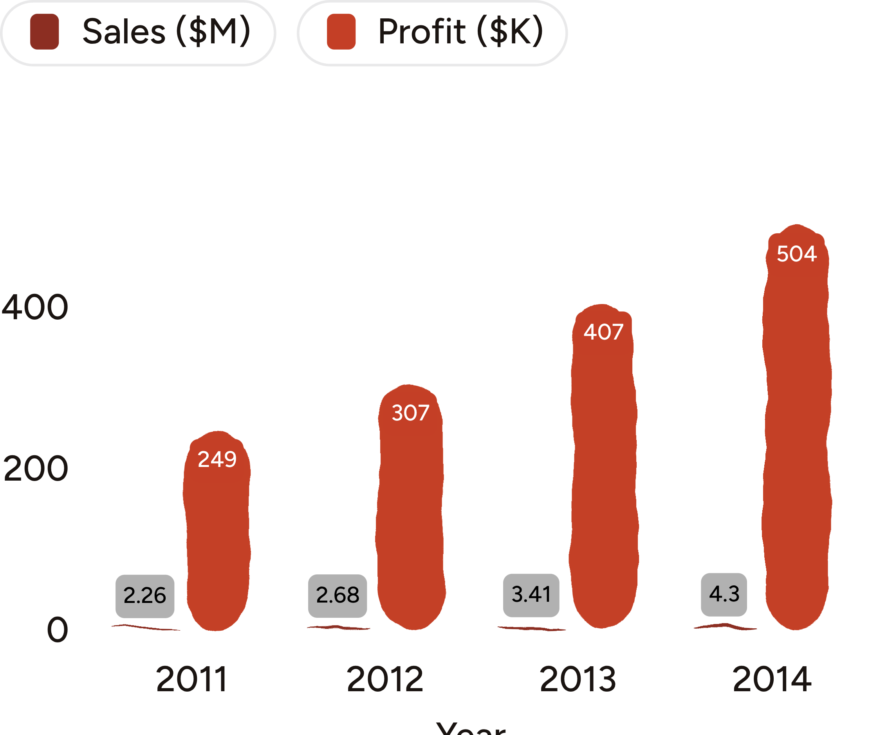
Four years of growth improved the profit engine
Sales grew from $2.26M in 2011 to $4.30M in 2014.
Profit rose from $249K to $504K.
Sales increased 90%; profit increased 103%.
Overall profit ratio: 11.6%.
Notes:
Sales and profit both rise each year, with profit growing slightly faster. The overall profit ratio is 11.6%.

Slide 3
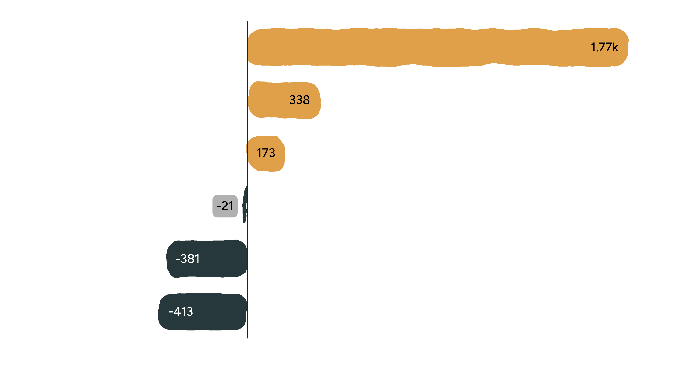
Discounting above 20% turns growth into loss
No-discount orders generated $1.77M in profit.
The 21–30% band was already negative at -$21K.
Discounts of 31% or more lost about $794K combined.
The clearest controllable lever is discount governance.
Notes:
Profit falls sharply as discounts move above 20%. The 21–30% band is already negative, and discounts of 31% or more lost about $794K combined.

Slide 4
Tables is the only sub-category losing money
Area | Sales | Profit | Profit ratio
Technology | $4.74M | $664K | 14.0%
Office Supplies | $3.79M | $518K | 13.7%
Furniture | $4.11M | $285K | 6.9%
Tables | $757K | -$64K | -8.5%
Copiers | — | $259K | —
Phones | — | $217K | —
Copiers and Phones were the strongest profit contributors. Furniture was the weakest category at a 6.9% profit ratio.
Notes:
Tables generated $757K in sales but lost $64K, with a -8.5% margin. It is the only negative sub-category.

Slide 5

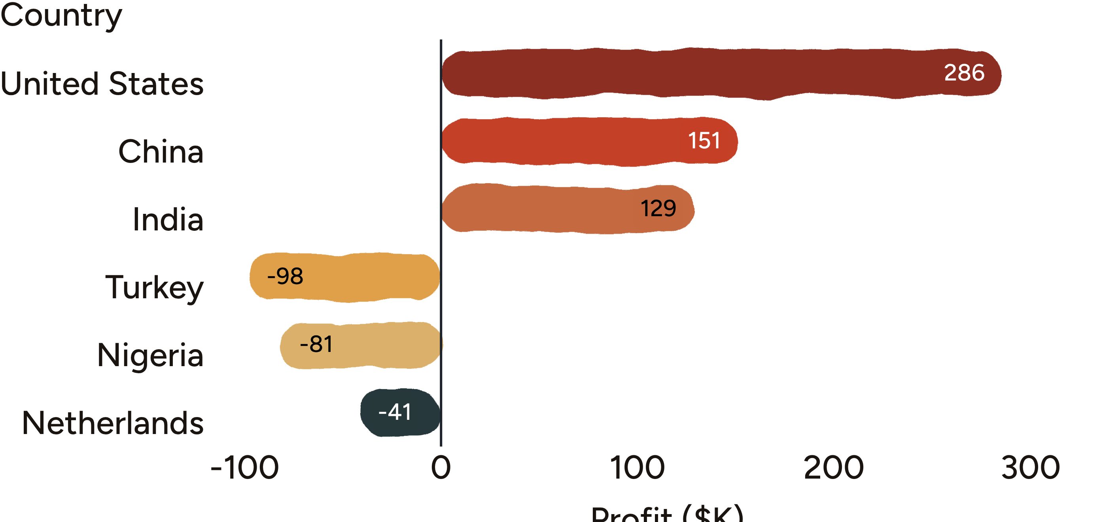
Country losses are concentrated in a few markets
A small set of countries drives both the strongest gains and deepest losses.
Notes:
The United States led profit at $286K, followed by China at $151K and India at $129K. Turkey and Nigeria together gave back about $179K. EMEA had the lowest market profit ratio at 5.4%.

Slide 6
Customer value varies sharply, while segments stay balanced
SEGMENT PROFIT RATIOS
Consumer
11.5%
Corporate
+$8.7K
12.0%
Home Office
Most profitable customer: Tamara Chand
11.7%
-$6.2K
Segment mix is not the main issue; account and order economics are.
Biggest customer-level loss: Cindy Stewart
Notes:
Customer value varies sharply, but Consumer, Corporate, and Home Office segments remain balanced at 11.5% to 12.0% profit ratios. The issue is account and order economics.

Slide 7

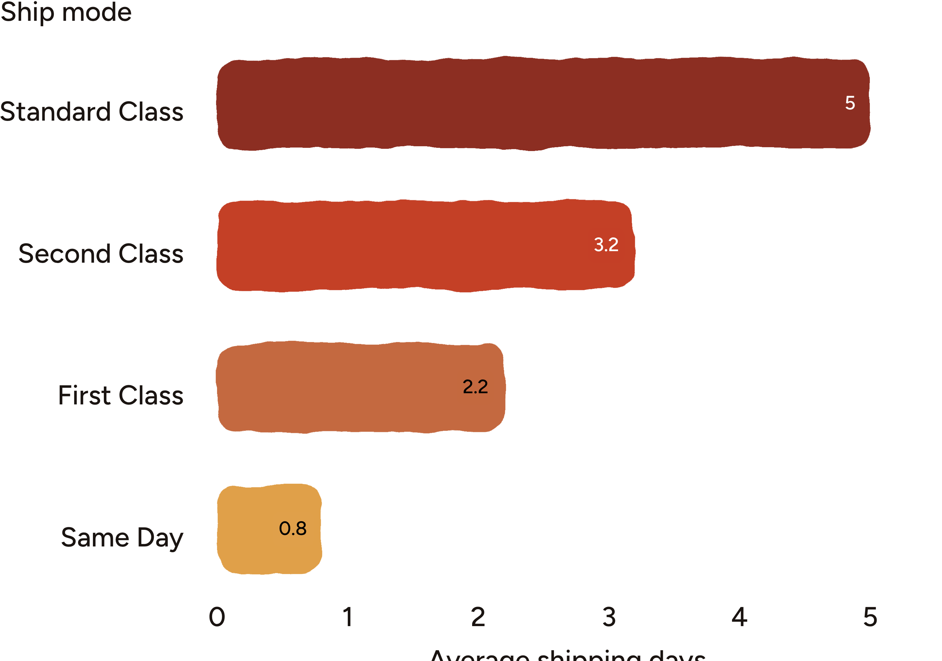
Shipping speed comes with a clear service trade-off
Faster service modes materially reduce delivery time.
Notes:
Standard Class averages about 5 days, Second Class about 3.2, First Class about 2.2, and Same Day under one day. Shipping cost by country is the next analysis needed to explain the largest losses.

Slide 8

The project turns messy order data into decision-ready analysis
1
Cleaned 51,290 order-line records across 27 raw columns.
2
Validated nulls, duplicates, duplicate IDs, and invalid shipping dates — all checks returned zero.
3
Engineered order year, month, quarter, shipping days, profit margin, loss flag, and discount bands.
4
Connected the cleaned data to two interactive Tableau dashboards.
Tools: Python and pandas for preparation; Tableau Public for dashboards; GitHub for delivery.
Notes:
The project moved from raw order-line records to validated, engineered data and two interactive Tableau dashboards. Python and pandas prepared the data; Tableau Public and GitHub supported delivery.

Slide 9
Three actions can protect the next dollar of profit
1
Cap discounts at 20%
Require approval for anything higher.
2
Fix Tables economics
Review pricing, mix, and the roughly 29% average discount.
3
Investigate Turkey, Nigeria, and EMEA
Isolate discount, shipping-cost, and product-mix effects before repricing or exiting.
Protect Copiers, Phones, and Accessories — the strongest performers — while extending analysis with shipping-cost and RFM segmentation work.
Notes:
The immediate actions are to govern discounts, fix Tables economics, and investigate the concentrated country and regional losses. Protect Copiers, Phones, and Accessories while extending the analysis with shipping-cost and RFM segmentation work.

